Slide 1

CHEME 5500 Software Carpentry
Python – A Crash Course
Esoteric Sections
Principal Component Analysis

Slide 2
Principal Component Analysis
A method of reducing the dimensionality of a problem to emphasize the variability
Useful for data analysis of “big data”
Can help isolate outliers, or data sets of interest

Slide 3
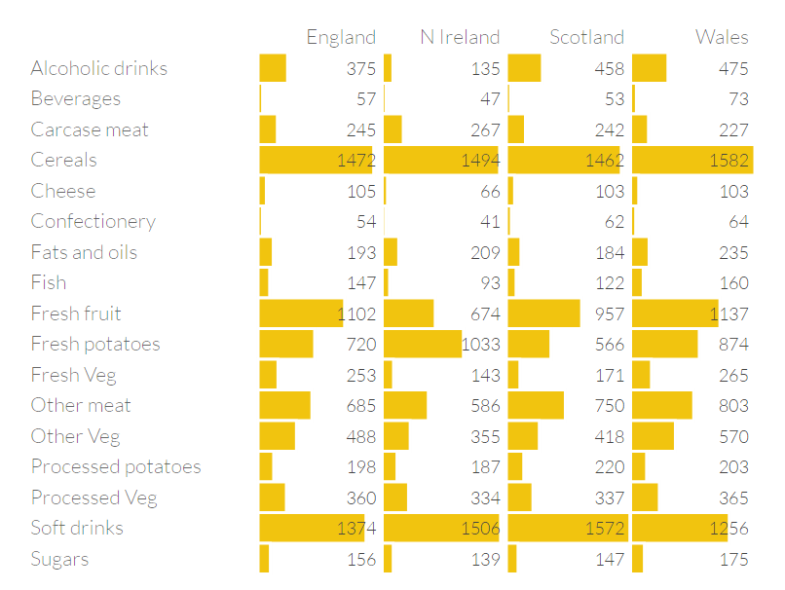
Average Consumption of Food
http://setosa.io/ev/principal-component-analysis/

Slide 4
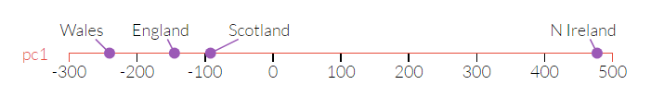
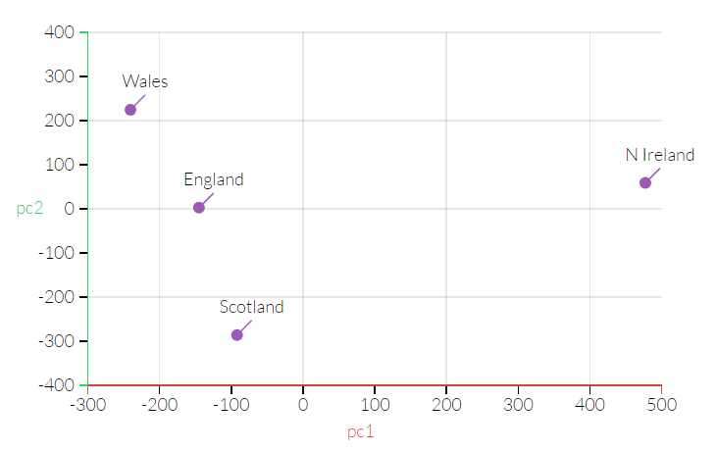
Average Consumption of Food
http://setosa.io/ev/principal-component-analysis/

Slide 5

How does it work?
Definitions:
$$\overline{x}=\frac{1}{N}\sum_{i}^{N}{x_{i}}$$
$$σ=\sqrt{\frac{\sum_{i}^{N}{{\left(x_{i}−\overline{x}\right)}^{2}}}{N −1}}$$
$$var\left(x\right)=σ^{2}=\frac{\sum_{i}^{N}{(x_{i}−\overline{x})(x_{i}−\overline{x})}}{N−1}$$
$$cov\left(x,y\right)=\frac{\sum_{i}^{N}{(x_{i}−\overline{x})(y_{i}−\overline{y})}}{N−1}$$
Notes:
N-1 for sample
N for entire population

Slide 6

How does it work?
Definitions:
Let $Z$ be a set of all sets (ex, in 2D $Z=[X, Y]$)
$$C= \left[\begin{matrix}cov\left(Z_{0},Z_{0}\right) & ⋯ & cov\left(Z_{0},Z_{N}\right) \\ ⋮ & ⋱ & ⋮ \\ cov\left(Z_{N},Z_{0}\right) & ⋯ & cov\left(Z_{N},Z_{N}\right)\end{matrix}\right]$$
Notes:
Note, more information found here:
www.cs.otago.ac.nz/cosc453/student_tutorials/principal_components.pdf

Slide 7
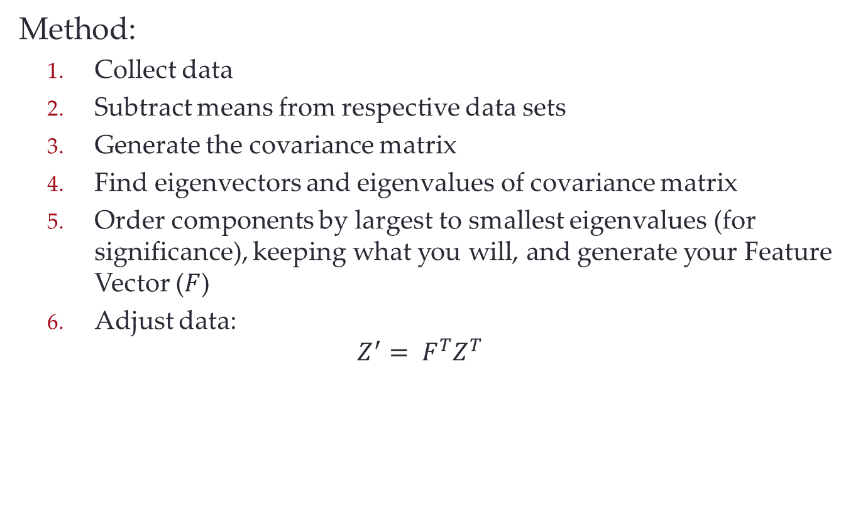
How does it work?
Method:
Collect data
Subtract means from respective data sets
Generate the covariance matrix
Find eigenvectors and eigenvalues of covariance matrix
Order components by largest to smallest eigenvalues (for significance), keeping what you will, and generate your Feature Vector ($F$)
Adjust data:
$$Z^{′}= F^{T}Z^{T}$$
Notes:
Feature vector is simply the vector of eigenvectors
Z is now as follows:
| Z_00 Z_01 Z_02 …
| Z_10 Z_11 Z_12 …
| …
| Z_N0 Z_N1 Z_N2…
As such, Z’ has columns of data and rows of dimensions

Slide 8
Let’s do an example

